Slide 1
Building Microservices
Sachin Deokar

Slide 2
About Me

Slide 3
AGENDA
Monolith
Microservices
Moving to Microservices
Principles
Pre-requisite

Slide 4
UI
?? Don’t know what this is ??
Service A
Service B
Service A1
Service B2
Bug Fix
?? Don’t know what this is ??
Don’t have time to refactor
Service C
Service D
Service D1
Bug Fix
Bug Fix
Not in use but afraid to remove
Service E
?? Don’t know what this is ??
Service B1
Don’t Change: It works somehow
Bug Fix
Bug Fix
Bug Fix
Bug Fix
?? Don’t know what this is ??

Slide 5
Benefits
Challenges
Simple to develop
Simple to test
Simple to deploy
Simple to scale horizontally
Complex
Overloaded web container
Continuous deployment is difficult
Scaling - The scalability is limited to Load Balancing
Zero downtime deployments become rather complicated, especially for stateful applications
Development with multiple teams is inefficient and requires a lot of coordination
Requires a long-term commitment to a technology stack

Slide 6
Microservices

Slide 7
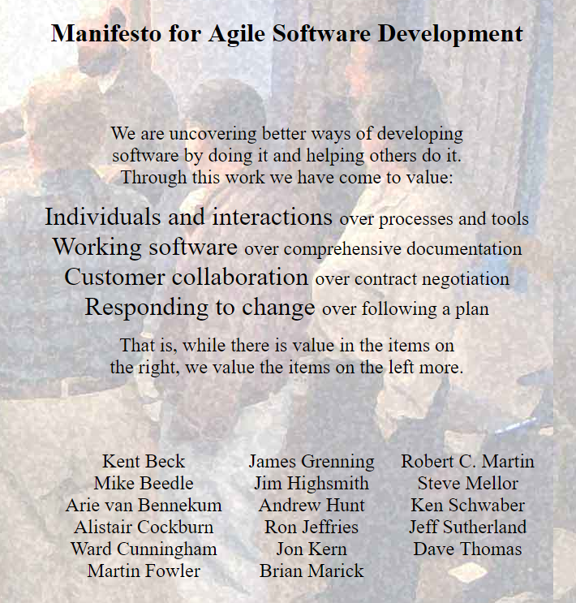
Microservices
The microservice architectural style is an approach to developing a single application as a suite of small services, each running in its own process and communicating with lightweight mechanisms, often an HTTP resource API.
These services are built around business capabilities and independently deployable by fully automated deployment machinery.
There is a bare minimum of centralized management of these services, which may be written in different programming languages and use different data storage technologies.
James Lewis and Martin Fowler
http://martinfowler.com/microservices/#what

Slide 8
Suite of small services, each running in its own process, built around business capabilities and independently deployable

Slide 9
Principles of Microservices
Products not Projects
Single Responsibility Principle
Decentralized Data Management
Organize Around Business Capabilities
Deploy Independently
Design For Failure

Slide 10
Principles of Microservices
Products not Projects
Single Responsibility Principle
Decentralized Data Management
Organize Around Business Capabilities
Deploy Independently
Design For Failure

Slide 11
“you build it, you run it”
Werner Vogels 2006

Slide 12
Principles of Microservices
Products not Projects
Single Responsibility Principle
Decentralized Data Management
Organize Around Business Capabilities
Deploy Independently
Design For Failure

Slide 13
Single Responsibility Principle
1
DO
THING
AND DO IT WELL

Slide 14
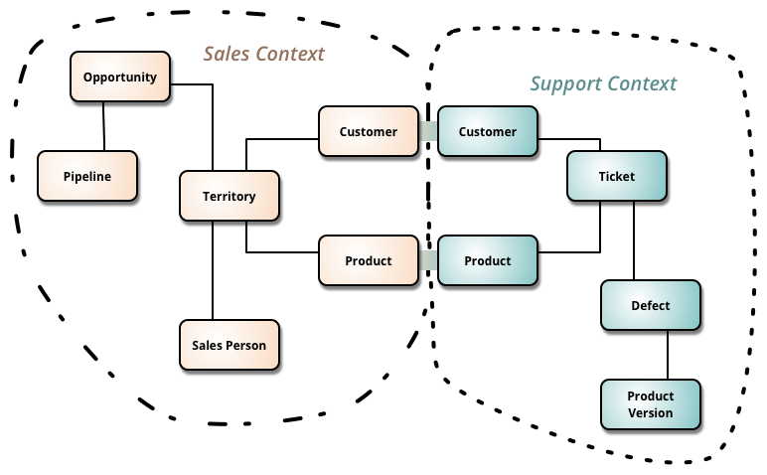
Bounded Context
Domain Driven Design deals with large models by dividing them into different Bounded Contexts and being explicit about their interrelationships
https://martinfowler.com/bliki/BoundedContext.html

Slide 15
Principles of Microservices
Products not Projects
Single Responsibility Principle
Decentralized Data Management
Organize Around Business Capabilities
Deploy Independently
Design For Failure

Slide 16
Decentralized Data Management

Slide 17
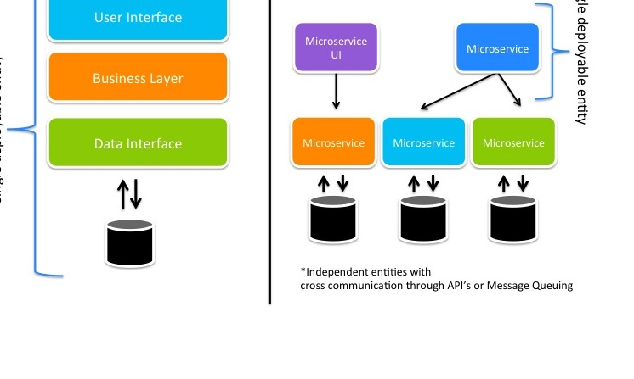
Decentralized Data Management

Slide 18
Principles of Microservices
Products not Projects
Single Responsibility Principle
Decentralized Data Management
Organize Around Business Capabilities
Deploy Independently
Design For Failure

Slide 19
Organize Around Business Capabilities
Conway's Law
"Any organization that designs a system … will inevitably produce a design whose structure is a copy of the organization's communication structure.”
-- Melvin Conway, 1968

Slide 20



Organize Around Business Capabilities
Siloed Functional Teams
UI Specialists
Middle Tier Specialists
DBA’s
Siloed Application Architectures
HTML
JavaScript
JSP
AngularJS
Data Access
Business Service
Controllers/Servlets
Business Logic

Slide 21

Organize Around Business Capabilities
Product Catalog
Invoices
Payments
Inventory
Cross Functional Teams
Microservice Architecture

Slide 22
Principles of Microservices
Products not Projects
Single Responsibility Principle
Decentralized Data Management
Organize Around Business Capabilities
Deploy Independently
Design For Failure

Slide 23
One Service Per Host
VS
Host
Host
Host
Host
Host

Slide 24
Principles of Microservices
Products not Projects
Single Responsibility Principle
Decentralized Data Management
Organize Around Business Capabilities
Deploy Independently
Design For Failure

Slide 25


Design for failure

Slide 26
Circuit Breaker Pattern

Slide 27
Circuit Breaker Pattern

Slide 28
Principles of Microservices
Products not Projects
Single Responsibility Principle
Decentralized Data Management
Organize Around Business Capabilities
Deploy Independently
Design For Failure

Slide 29
Microservices
Suite of small services, each running in its own process, built around business capabilities and independently deployable

Slide 30
Microservice Prerequisites

Slide 31
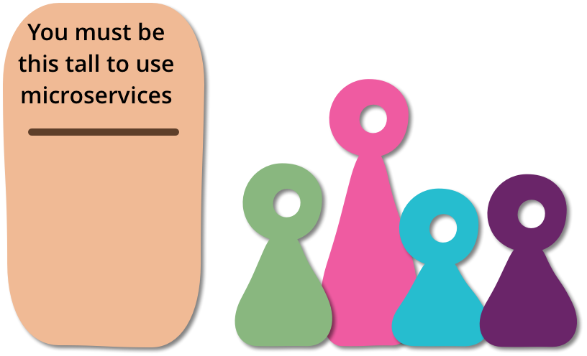
Microservice Prerequisites
Before you go into production with a microservices system, you need to ensure that you have key prerequisites in place
Testing
Automation
Continuous Delivery
Rapid Application Deployment
Rapid Provisioning
Basic Monitoring
Evolutionary Architecture
Devops Culture
http://martinfowler.com/bliki/MicroservicePrerequisites.html

Slide 32
Microservice Prerequisites
Before you go into production with a microservices system, you need to ensure that you have key prerequisites in place
Testing
Automation
Continuous Delivery
Rapid Application Deployment
Rapid Provisioning
Basic Monitoring
Evolutionary Architecture
Devops Culture
http://martinfowler.com/bliki/MicroservicePrerequisites.html

Slide 33
Test Pyramid
Functional Tests
System Integration (API) Tests
Application Integration Tests
Contract Tests
Unit Tests

Slide 34
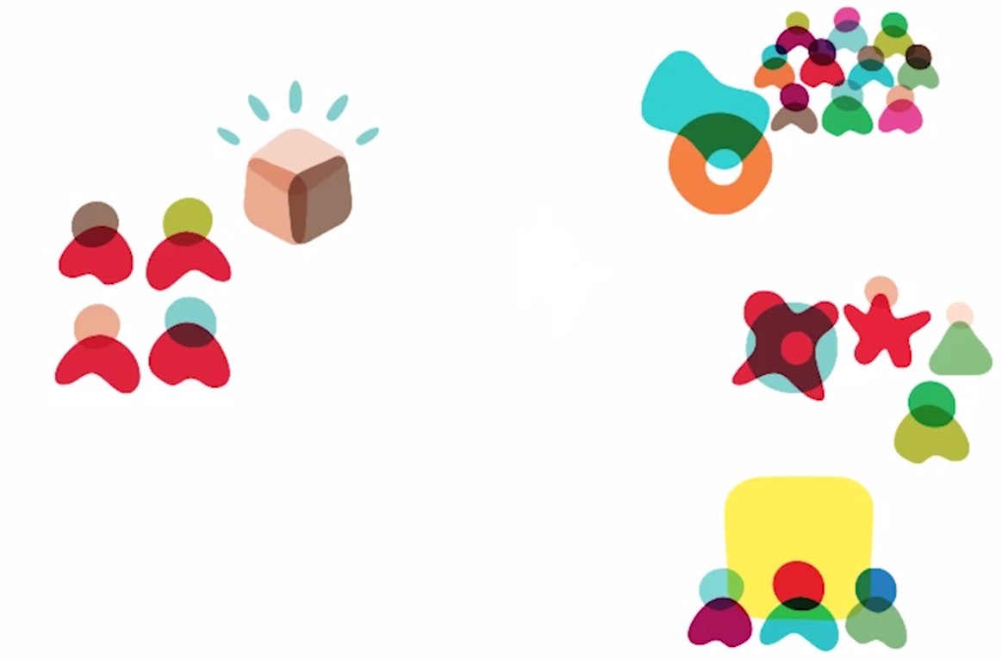
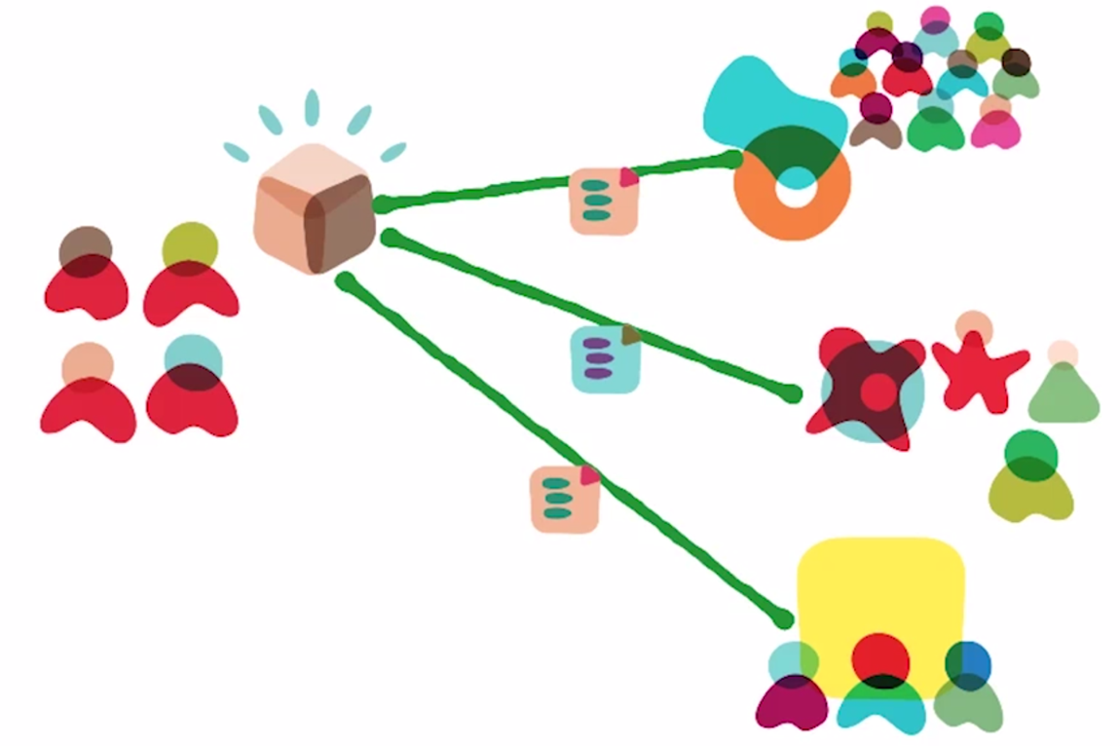
Consumer Driven Contracts

Slide 35
Microservice Prerequisites
Before you go into production with a microservices system, you need to ensure that you have key prerequisites in place
Testing
Automation
Continuous Delivery
Rapid Application Deployment
Rapid Provisioning
Basic Monitoring
Evolutionary Architecture
Devops Culture
http://martinfowler.com/bliki/MicroservicePrerequisites.html

Slide 36
Microservice Prerequisites
Before you go into production with a microservices system, you need to ensure that you have key prerequisites in place
Testing
Automation
Continuous Delivery
Rapid Application Deployment
Rapid Provisioning
Basic Monitoring
Evolutionary Architecture
Devops Culture
http://martinfowler.com/bliki/MicroservicePrerequisites.html

Slide 37
Automation and Continuous Delivery
Continuous delivery as first class citizen
Goal is to make deployment a predictable process that can be performed on demand.
Infrastructure as code
Automate everything
Immutable Deployments
Avoid snowflake servers

Slide 38
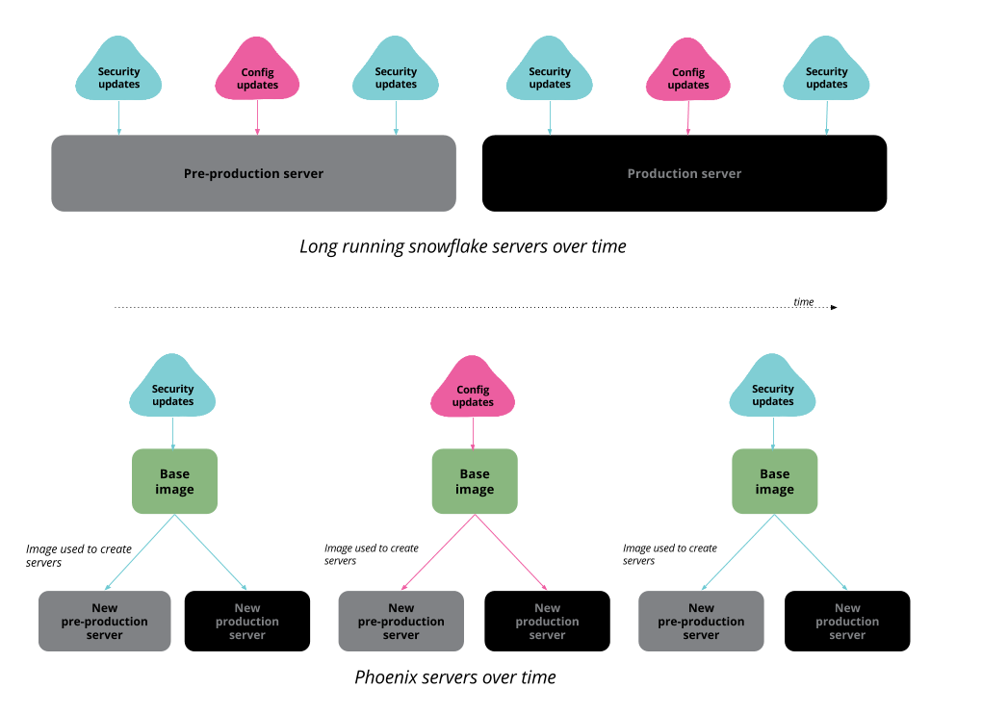


Immutable Deployments: Snowflake vs Phoenix Servers
Applying changes to Server Instance manually leads to unique and distinct server configuration footprint
https://martinfowler.com/bliki/SnowflakeServer.html
Notes:
The first problem with a snowflake server is that it's difficult to reproduce. Should your hardware start having problems, this means that it's difficult to fire up another server to support the same functions. If you need to run a cluster, you get difficulties keeping all of the instances of the cluster in sync. You can't easily mirror your production environment for testing. When you get production faults, you can't investigate them by reproducing the transaction execution in a development environment.

Slide 39
Microservice Prerequisites
Before you go into production with a microservices system, you need to ensure that you have key prerequisites in place
Testing
Automation
Continuous Delivery
Rapid Application Deployment
Rapid Provisioning
Basic Monitoring
Evolutionary Architecture
Devops Culture
http://martinfowler.com/bliki/MicroservicePrerequisites.html

Slide 40
Microservice Prerequisites
Before you go into production with a microservices system, you need to ensure that you have key prerequisites in place
Testing
Automation
Continuous Delivery
Rapid Application Deployment
Rapid Provisioning
Basic Monitoring
Evolutionary Architecture
Devops Culture
http://martinfowler.com/bliki/MicroservicePrerequisites.html

Slide 41
Microservice Prerequisites
Before you go into production with a microservices system, you need to ensure that you have key prerequisites in place
Testing
Automation
Continuous Delivery
Rapid Application Deployment
Rapid Provisioning
Basic Monitoring
Evolutionary Architecture
Devops Culture
http://martinfowler.com/bliki/MicroservicePrerequisites.html

Slide 42
Microservice Prerequisites
Before you go into production with a microservices system, you need to ensure that you have key prerequisites in place
Testing
Automation
Continuous Delivery
Rapid Application Deployment
Rapid Provisioning
Basic Monitoring
Evolutionary Architecture
Devops Culture
http://martinfowler.com/bliki/MicroservicePrerequisites.html

Slide 43
Microservice Prerequisites
Before you go into production with a microservices system, you need to ensure that you have key prerequisites in place
Testing
Automation
Continuous Delivery
Rapid Application Deployment
Rapid Provisioning
Basic Monitoring
Evolutionary Architecture
Devops Culture
http://martinfowler.com/bliki/MicroservicePrerequisites.html

Slide 44
Microservice Prerequisites
Before you go into production with a microservices system, you need to ensure that you have key prerequisites in place
Testing
Automation
Continuous Delivery
Rapid Application Deployment
Rapid Provisioning
Basic Monitoring
Evolutionary Architecture
Devops Culture
http://martinfowler.com/bliki/MicroservicePrerequisites.html

Slide 45
Moving to Microservices

Slide 46
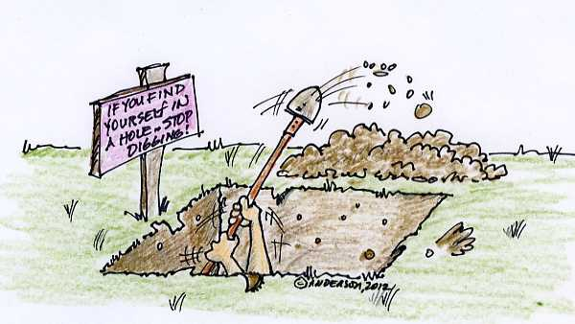
RESTRAINT - Stop Digging
The Law of Holes says that whenever you are in a hole you should stop digging.
Do not put more stuff into your monolith!
But be prepared that you won’t be able to move to a more agile version of your software overnight – it might take a while, but it’s worth it.

Slide 47
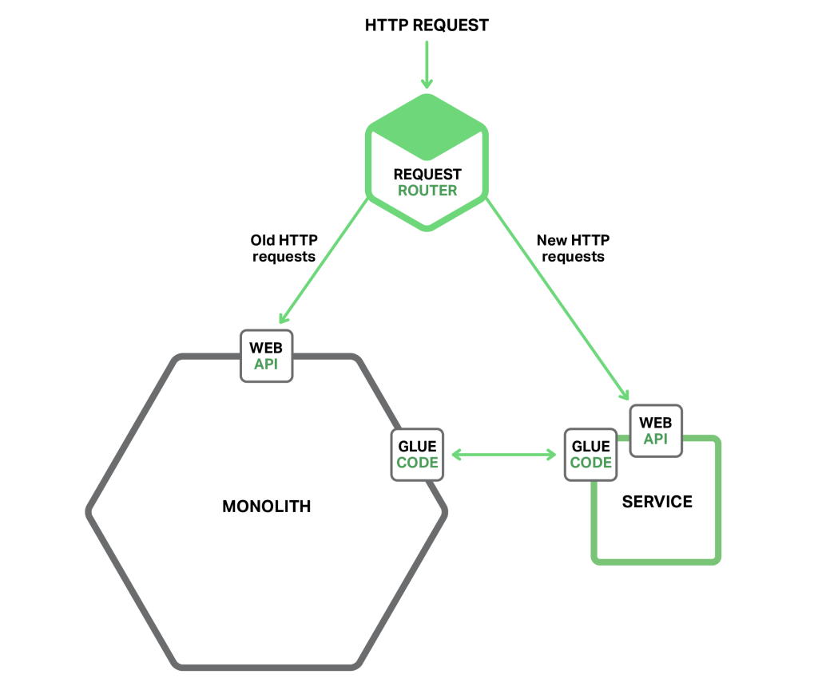
RESTRAINT - Stop Digging
When you are implementing new functionality you should not add more code to the monolith.
Instead, put that new code in a standalone microservice.

Slide 48
NO MORE NEW BIG FEATURES!

Slide 49


FIXES AND SMALL CHANGES ONLY!

Slide 50
NO FACELIFT PROJECTS!

Slide 51
Moving to Microservices might be a too drastic step and is not recommended as a "Grand Redesign" project.
Strangler Pattern and/or Self-Contained Systems (SCS) are viable alternatives!

Slide 52

Strangler Pattern

Slide 53
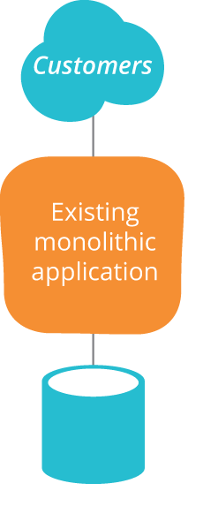
Strangler Pattern

Slide 54
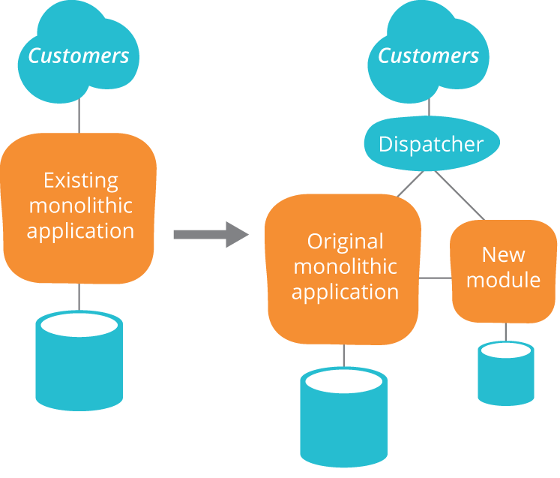
Strangler Pattern

Slide 55
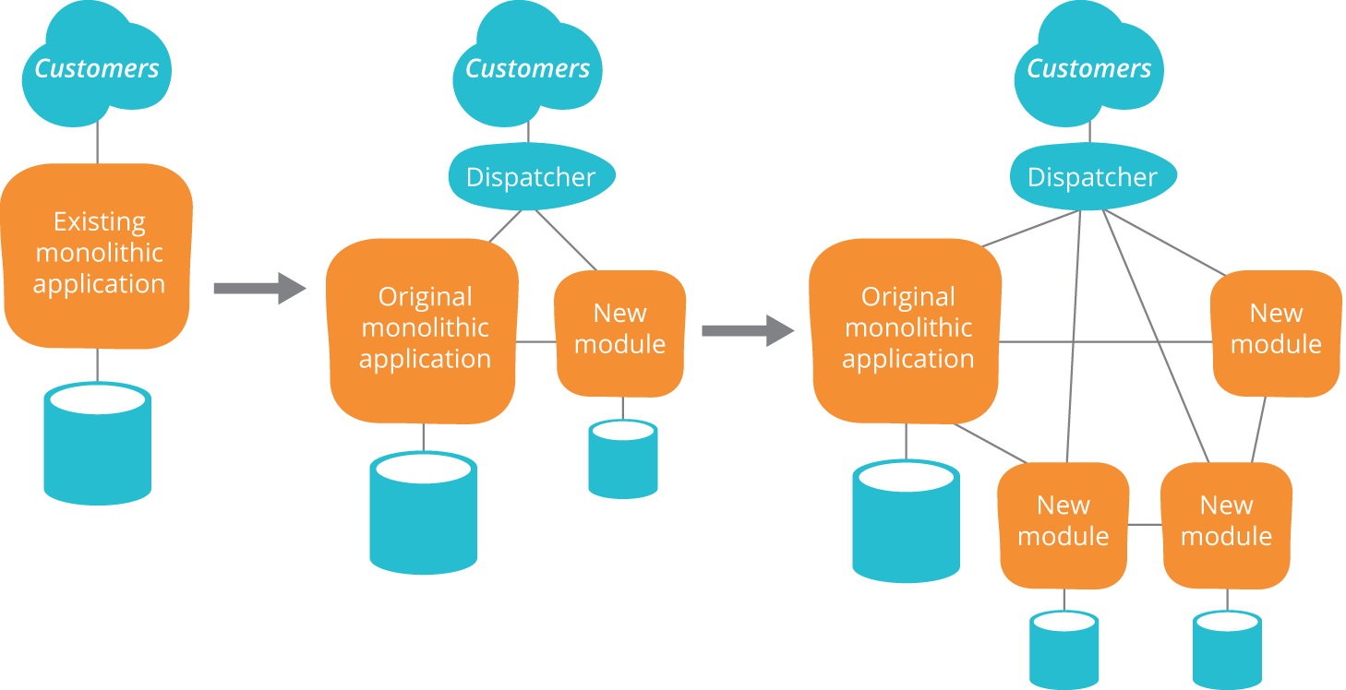
Strangler Pattern

Slide 56
Self Contained System (SCS)

Slide 57
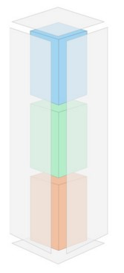
SELF-CONTAINED SYSTEM (SCS)
An SCS contains its own user interface, specific business logic and separate data storage
Autonomous web application (including UI, Logic and Data)
Prefers asynchronous integration
Individually deployable
Owned by one team

Slide 58
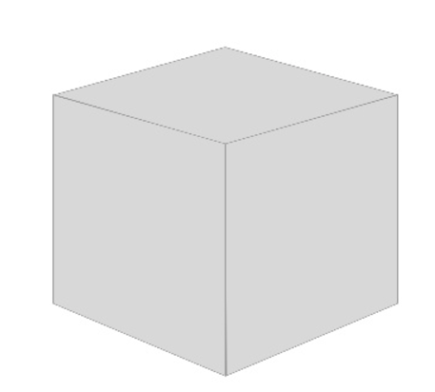

Slide 59
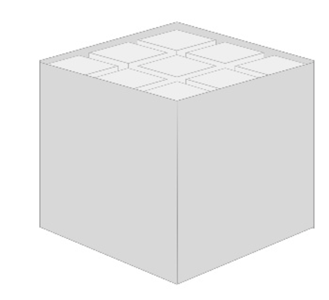
Various Domains

Slide 60
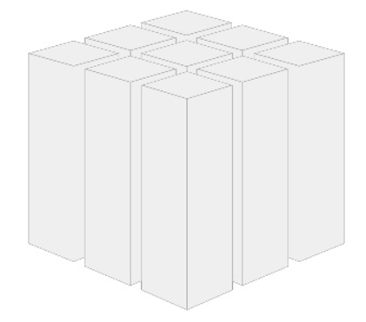
Vertical Decomposition
Cut Monolith along domains

Slide 61
Vertical Decomposition
UI
UI
Notification
Client
Payment
Payer

Slide 62
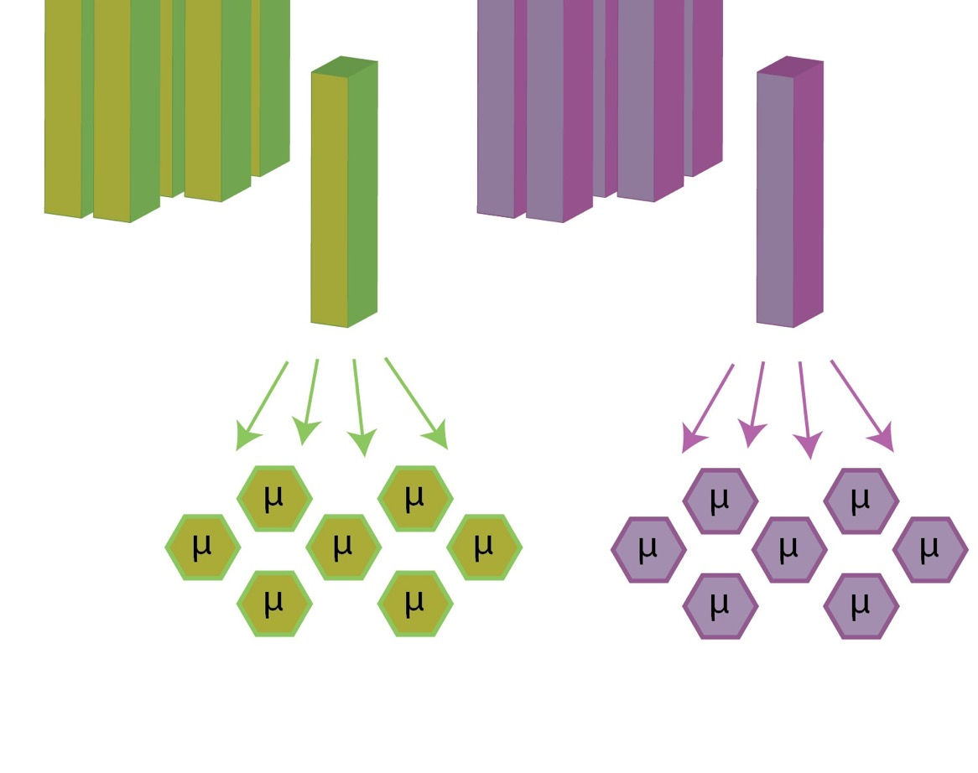
Breaking Self-Contained Systems Further Down into Microservies

Slide 63
Benefits
Challenges
Strong Module Boundaries
Independent Deployments
Lower risk of deployment
Improved fault isolation
Technology Diversity
Easier to test
Easier to monitor
Can be versioned independently
Decomposed systems (1 system per server/jvm)
Replaceability
Complex infrastructure
Harder to Monitor (way more of them)
Discovery and Documentation tools
Complex deployment process (more builds)
More Databases
Increased network communication (in-process method calls vs inter-process communication)

Slide 64
{ “questions”: “?” }

Slide 65
Thank You

